Slide 1
FASTAG 2.0
An improved Ecosystem for smoother commute
Team: JUST_DO_IT

Slide 2
Team Details
Akshata Kulkarni
[back-end, data-architecture]
Gaurav Kumar
[back-end, data-architecture]
Kanchan Pal
[back-end, data-architecture]
Nikhil Ranjan Sinha
[back-end, data-architecture]
Saurabh R Nayak
[back-end, data-architecture]

Slide 3
Problem Statement
Improper implementation of hardware at tolls leading to duplicate proximity payments and depleting the customer satisfaction.
Inappropriate lane selection by confused public creating discomfort for the toll collectors to bear the impact of angry road users.
Management of consumer complaints and its rectification is unsatisfactory .
Some toll operator swindle the user by misguiding them that the RFID/Scanner had failed scanning and charge cash for the toll.
Improving user experience and providing the users with proper guidelines and feedback.

Slide 4
Use Cases:
FASTag amount deducted without visiting toll plaza:
There are multiple occurrences of this issue in the internet filed by the users. An event had been recorded where the money from the user was deducted without installation of the fastag in his vehicle. Also several other issues stating the deduction of money from their e-wallet without visiting the toll plaza.
Source: https://www.complaintboard.in/complaints-reviews/paytm-fastag-l698203.html

Slide 5
Multiple charges made for a single scan:
It has been found that people are getting charged multiple times for a single scan during their journey. This would either be due to the faulty quality of the scanners or would be due to interference of adjacent scanners.
Source: https://www.consumercomplaints.in/fastag-deducted-twice-c2547231

Slide 6
Solutioning
Duplicate proximity payments:
This can be possibly due to two reasons.
Interference between scanners.
Multiple scans of the same tag.
Interference between scanners:
The interference issue could be since all the scanners in the toll plaza are functioning for a common frequency. We could be bringing in scanners with different frequency range for dedicated lanes for different TAG classes. But this would be inducing a change for the people currently owning a FASTag. This would be not feasible .
Time division Model - A simple concept of activating the scanners based on the time interval could help in solving the ambiguity and stop from a tag getting multiple scans or getting scanned by other lane scanners.
The other way to avoid this is by providing good shielding between the adjacent scanners by using some absorbing or reflecting materials. This method would only be making change at the inventory.

Slide 7
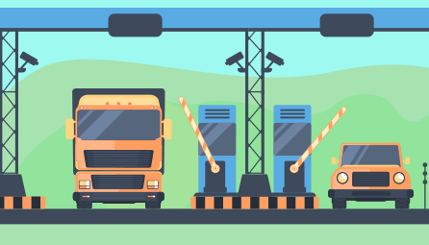
we just need to introduce a master slave architecture or a relay mechanism to activate the alternate toll gate scanners synchronously and adjacent scanners asynchronously. The time gap even if in milliseconds would do the job since the RF waves from scanners are of pretty high frequencies.
Master controller
The base flow of the intended design is shown. The identical colored lines are connected alternatively as stated. The scanners with different color will have opposite active state at any point of time. By proper positioning of the scanners and increased directionality so that the region of impact is confined by the particular toll gate boundary, along with the above mentioned time based switching would complement each other in increasing the functionality.
This could be the best modification made to tackle the interference problem for scanners with same frequency.
Fig:1
Lane1 RF transmitter
Lane2 RF transmitter
Lane3 RF transmitter
Lane4 RF transmitter
Fig:2
ROI

Slide 8
Multiple scans of the same tag:
To avoid the multiple scans of the same tag we could create a sleep time that restricts the tag from getting scanned consecutively in the same toll booth. We can also increase the distance of the regulatory barrier governing the vehicle, and add a relay switch to it so that only when the current scanned vehicle has travelled desirable distance and barricade is lifted the scanner would be turned on for the next vehicle. Another approach to tackle this is by governing the vehicles gps values and restricting the scanner from recording the tag after initial scan for a until the vehicle has crossed few area.

Slide 9
Inappropriate lane selection by confused public :
Its found that people are unable often get confused whether the lane is for their vehicle type or not. This would be creating unnecessary confusion at the toll collection region. Another issue faced by many are that after entering the lane its found that the lane is not functioning or under maintenance.
We are handling this problem by creating an app giving the user a complete idea of the current status of the tolls. This would give them info about the following facts:
=>Number of active lanes.
=>Lane status functioning/under maintenance.
=>Lane type FASTag/Cash.
=>Lane category heavy vehicle/light vehicle

Slide 10
Technology Stack
Backend solutioning
-Python 3.7
Web framework
-Flask 1.1
Frontend
-HTML 5
-Javascript
Database
-Flatfile,Mongo DB
API
-Rest API

Slide 11
Proof of concepts
We have successfully created 4 POCs to represent working prototypes of our ideas.
Dynamic Barcode Verification
Automated consumer complaint handler
UI model for complaint registration and status info to customer
Lane info webapp

Slide 12
Dynamic Barcode verification workflow
Webapp login
DB
End
verify
verified
success
Display Response
(Success/failed)
Collect user info
Display for scanning
Scanner
Generate barcode
Get the toll info from user/GPS
Generate a hash value with user info and time stamp making it unique
USER End
TOLL PLaza

Slide 13
This app brings the feature of generating unique barcode every time for the user, it’s a way to combat the outcome of poor functioning of RFID verification. In our app once the user is logged in the portal every time he approaches the tollbooth his app would detect the toll location by from his gps and generate a unique barcode with the users info along with the timestamp.
These data is hashed and encrypted making it unique and for one time usage. This encrypted data is stored in the silo for future referencing. One the other end the toll plazas will be equipped with barcode readers whose functioning in our POC is done by our web cam. These scanners will scan the barcode and verify the data with that in silo and determine whether the read hash is mapped to the particular user or if it’s a fraudulent one. Once the check is done it next verifies whether the user’s journey is one way or is it a return journey (within 24hr period).
Depending on the type of journey an entry is made and the required cash deduction request is triggered.

Slide 14
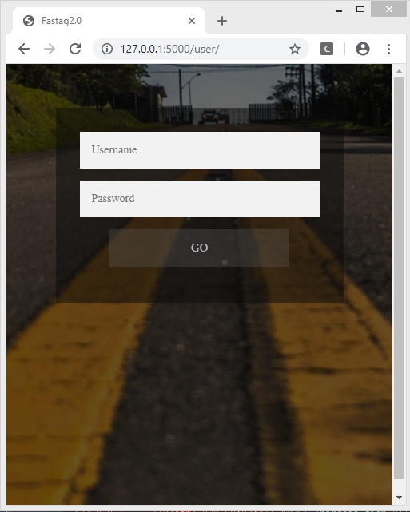
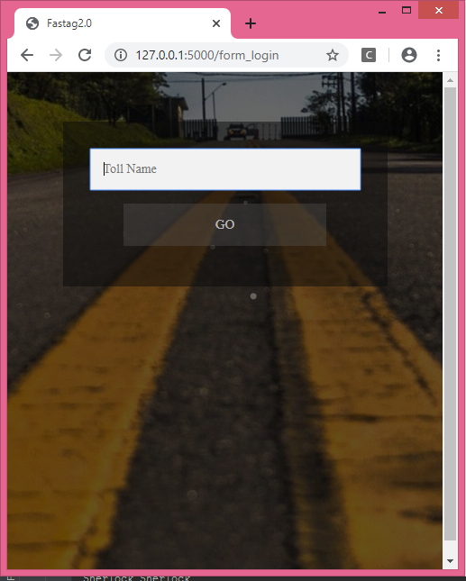
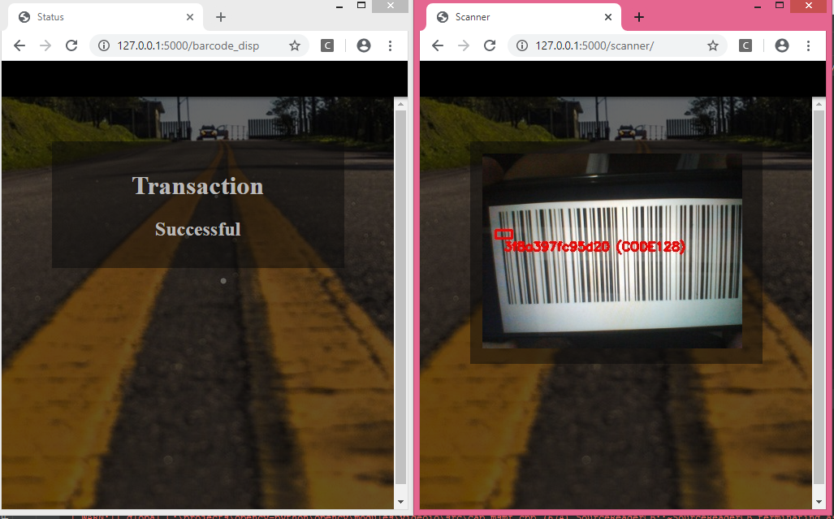
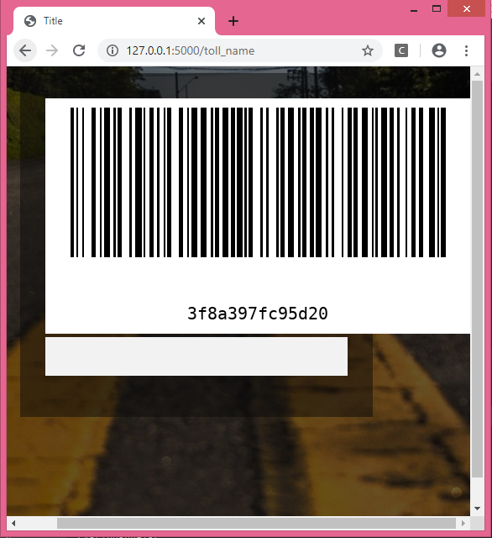
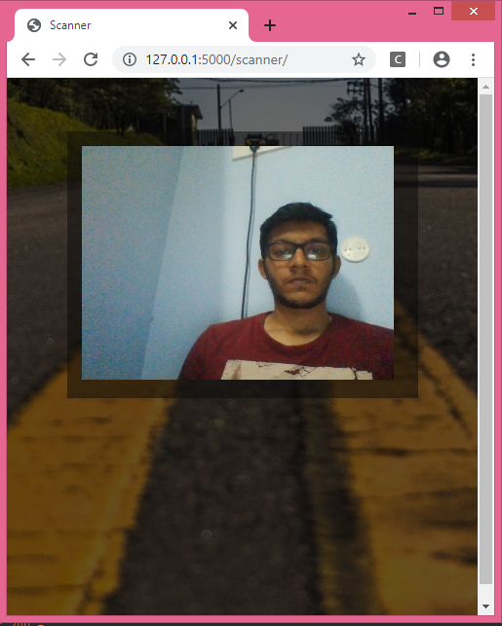
Real-time snaps
Log in
Toll detail
Scanning the code
Status
USER End
TOLL PLaza
Barcode Creation
Demo:
https://youtu.be/r1tgGqac0vE
Web cam feed

Slide 15
Automated consumer complaint handler:
Get timestamp
Complaint from user with transaction ID and other vehicle details
Video feed
DB
Get time of transaction
[TOT]
Get pics of the cars crossing
Get
users activity for a 24 band before and after TOT
Extract ROI [number plate]
Triggered by scheduler
once a day
Db
(Vehicle num +
Timestamp)
Verify complaint authentication from the counts
acknowledge bank the authenticity for further action
convert
image to text

Slide 16
This solution will impact on the consumer complaint handling sector. By adapting this we can automate the initial few steps from government’s end in authenticating the pleaded claims of the consumers. Our sequence of action can be divided into two parts. The first part is collection of the vehicular information crossing the toll plazas and parsing it. We are making use of the existing surveillance cameras setup near every toll barricades. The camera feed coming from here is used to capture the pictures of every car passing by, and store in a db with its captured timestamp.
Now that we have the data captured. We trigger a job once everyday using a scheduler. The action of this job is to go through the captured data for that day and extract the number plate data from the images. These data are stored in a macro db as a long term history.
The second part is customer complaint handler. Whenever the consumer raises the complaint with his transaction id and other vehicular details, the time of transaction and the vehicle number is taken. This is compared with our history db value for a time band of 24 hrs before and after from the customers transaction time. Now we get the count of the particular vehicles transition on the toll gates and validate the authenticity of the claim. If the claim is found to be valid, then the particular bank to which the user is registered is acknowledged to proceed with next steps from their end.

Slide 17
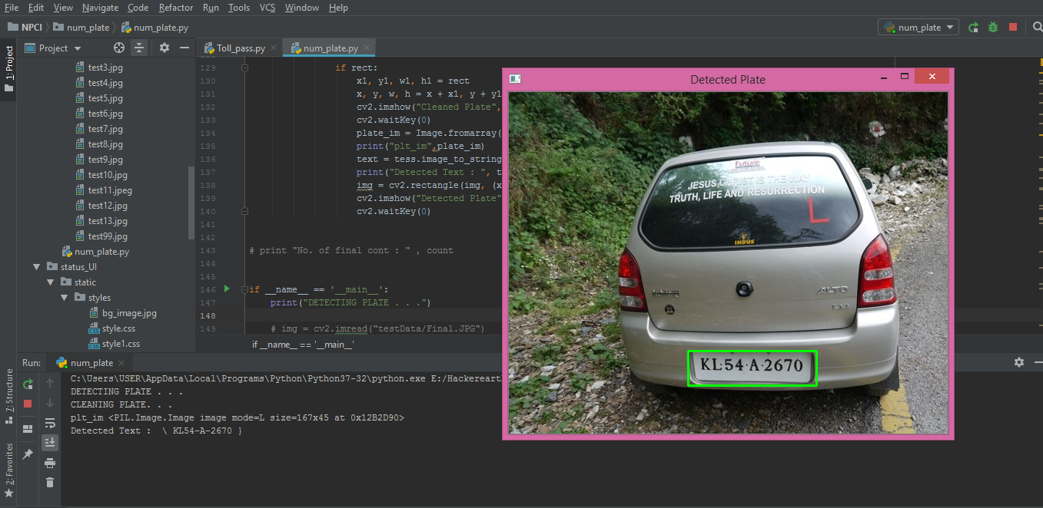
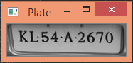
Real-time snaps
Extraction
Image to text conversion
Detection
https://youtu.be/3HsnW9Lz6qs

Slide 18
UI model for complaint registration and status info
Home
page
New
complaint
Get
status
Enter details
CONSUMER ID
TRANSACTION ID
DESCRIPTION
Enter complaint
id
Fetch status from DB
submit
submit
Step progress report of the status
Complaint
registered

Slide 19
This solution is aimed in giving the user a platform to easily raise the complaints they have. It also helps the users to check their status on their claim request. The webapp gives two options either to raise a new complaint or to get the status of the raised complaint. The user can select the needed option, fill the required details and submit the same. We have used mongodb as our silo. It’s a simple step to bring all the features under the hood.

Slide 20
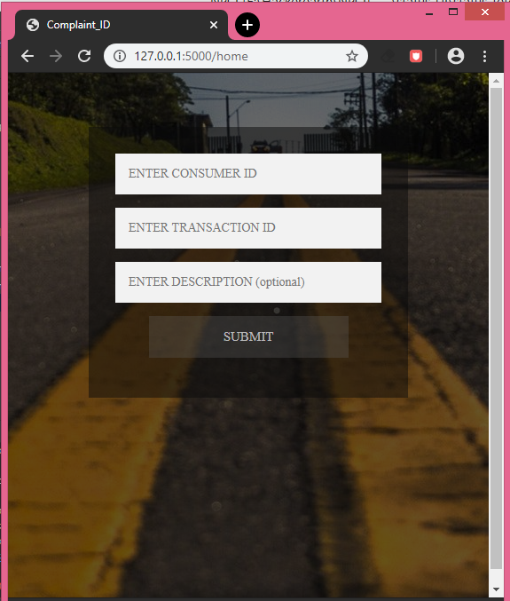
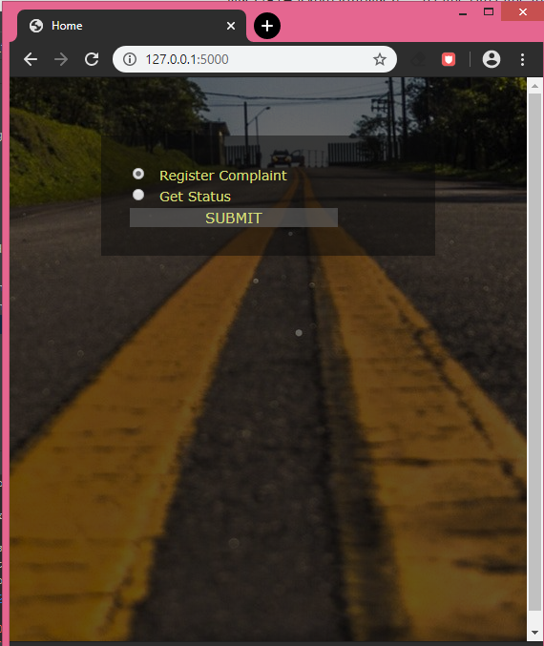
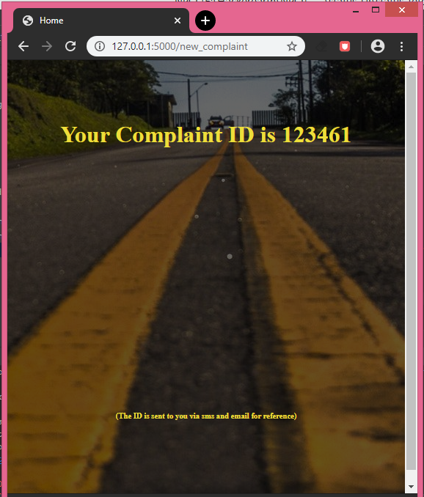

Real-time snaps
https://youtu.be/3HsnW9Lz6qs

Slide 21
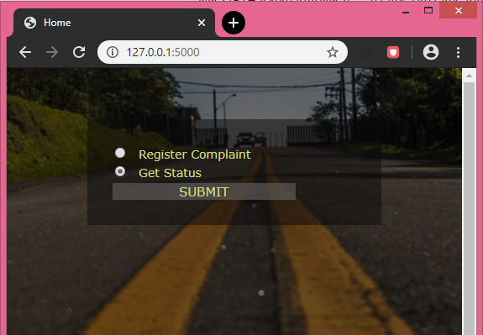
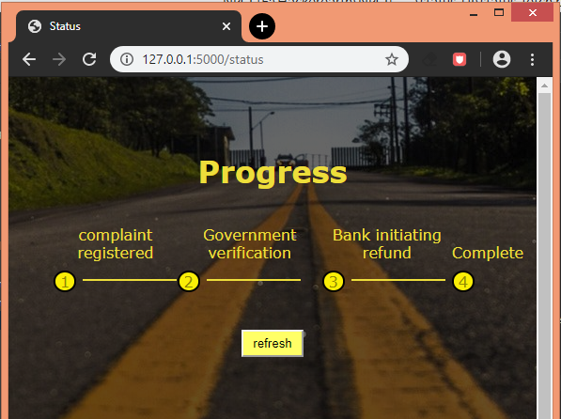
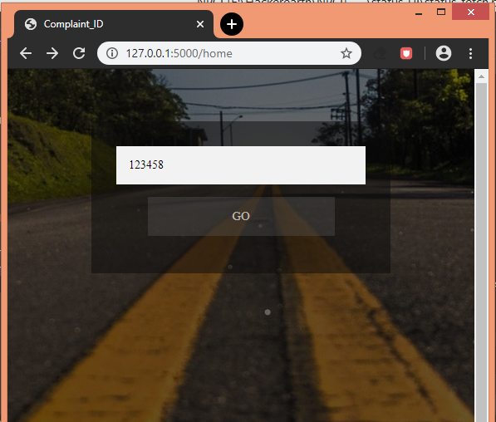

Slide 22
Lane info webapp
MASTER
coordinator
Toll plaza location/id
Fetch the required data
Webapp
Information cleansing
Source code of web page
Webpage describing the toll plaza
info
DB
Modify
data
The webpage contains the search bar.
The user can enter the toll name/id to get details.
(html,css)
The data about the lane will be present in a DB.
The data will be read from the sheet. Will b parsed in a way we want.
(python)
In the source code the data about info of tollgates will be replaced with latest one.
(python)

Slide 23
This is a simple webapp that gives the user the complete info of any toll he/she wants. The user just needs to enter the toll name or the id he/she wants and submit the same. This comes in handy for the user and helps to avoid any confusion in choosing a lane depending on his vehicle type and also lets the user the information about any lane under maintenance way before entering it.
We could also integrate this feature in the previous app and give a notification to the user prior approaching the (approx 500meters) toll by fetching the gps data of the user.

Slide 24
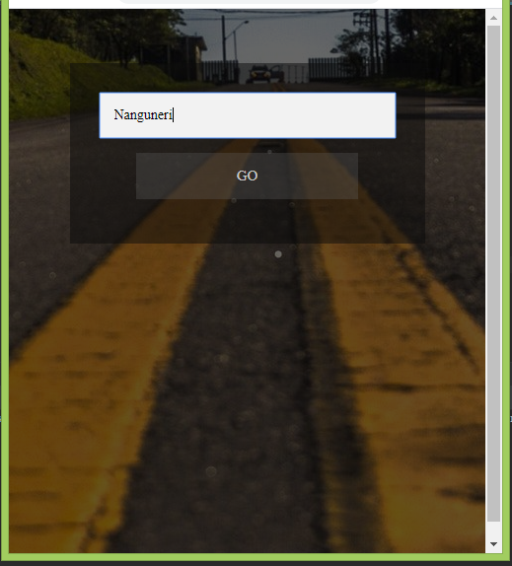
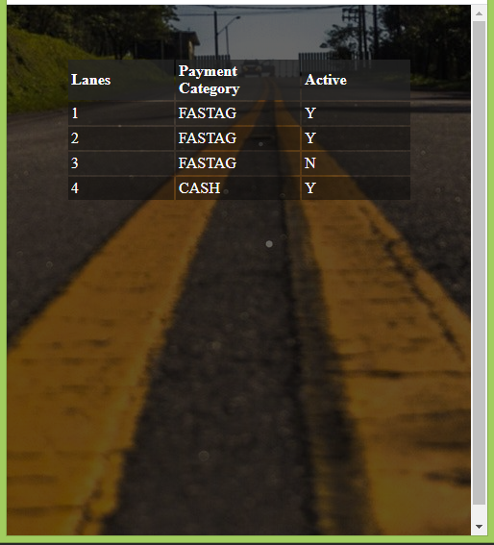
Enter the Toll location
real-time info

Slide 25
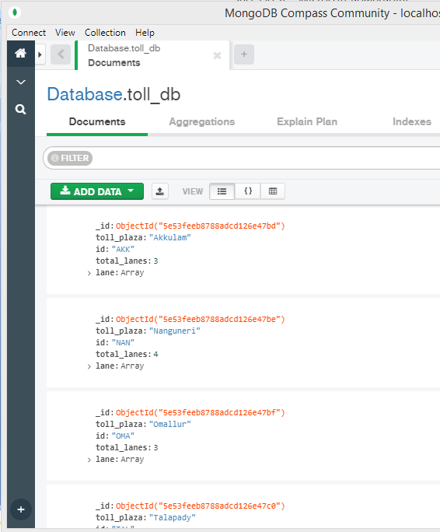
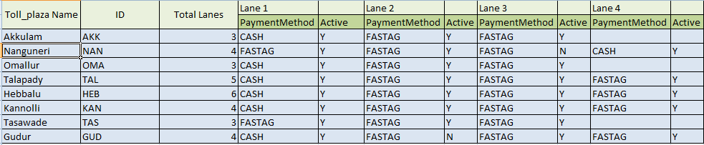
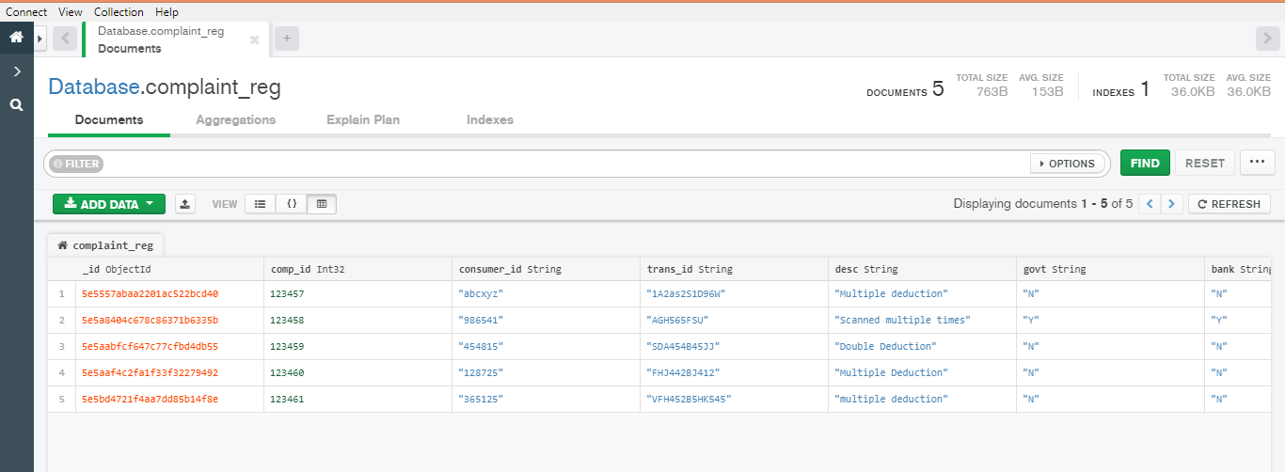
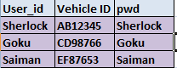
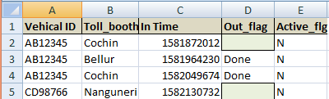
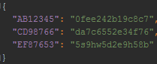
Data sample snaps
Toll Plaza Details
ConsumerComplaint registry
User data created for testing
Toll-plaza visit history infp
Users and their volatile hashcode

Slide 26
Resources
Github link:
https://github.com/SaurabhRNayak/Just_Do_It-NPCI_HACK
Youtube links:
https://youtu.be/r1tgGqac0vE
https://youtu.be/3HsnW9Lz6qs
References:
https://www.complaintboard.in/complaints-reviews/paytm-fastag-l698203.html
https://www.consumercomplaints.in/fastag-deducted-twice-c2547231
https://flask.palletsprojects.com/en/1.1.x/

